Slide 1



Knowledge Graphs with Neo4j as foundation for Conversational Interfaces
GraphAware, world’s #1 Neo4j consultancy
graphaware.com
@graph_aware

Slide 2
About me
Christophe Willemsen
From Belgium but living in Southern Italy
Principal Consultant at GraphAware
Expert in Graphs and Search
Currently researching in Natural Language Understanding and its implementation in chatbots
@ikwattro

Slide 3
Outline
How to represent Knowledge in a Graph
Text Processing
Processing Text
Information Extraction
Keywords Extraction
Enrichment
Concept Bases
Visual Content Metadata
External Knowledge Bases
Knowledge Graphs to power advanced applications
Our demo : Brain Bro
Knowledge Graphs in the Real Life
Phonetic issues
Soft Cosine Measure (SCM)
Visual and Temporal Memory for Recall

Slide 4

DOMAIN MODEL LAYER 1
TEXT UNDERSTANDING LAYER 2
KNOWLEDGE GRAPH LAYER 3
USER CONTEXT LAYER 4
Original domain model, for eg authors of news, news, views, original topics, etc.
Standard text processing features
Information Extraction
Enrichment
Facts
Knowledge Entities and Semantic relationships
Built from aggregation and validation of layer 1 and 2
Offers Multi-View (Perspectives)
Keeps track of the user conversation
Relates conversation steps to entry points in the Knowledge Graph
Use distance to determine out of context situations

Slide 5
How to represent Knowledge in a Graph?

Slide 6
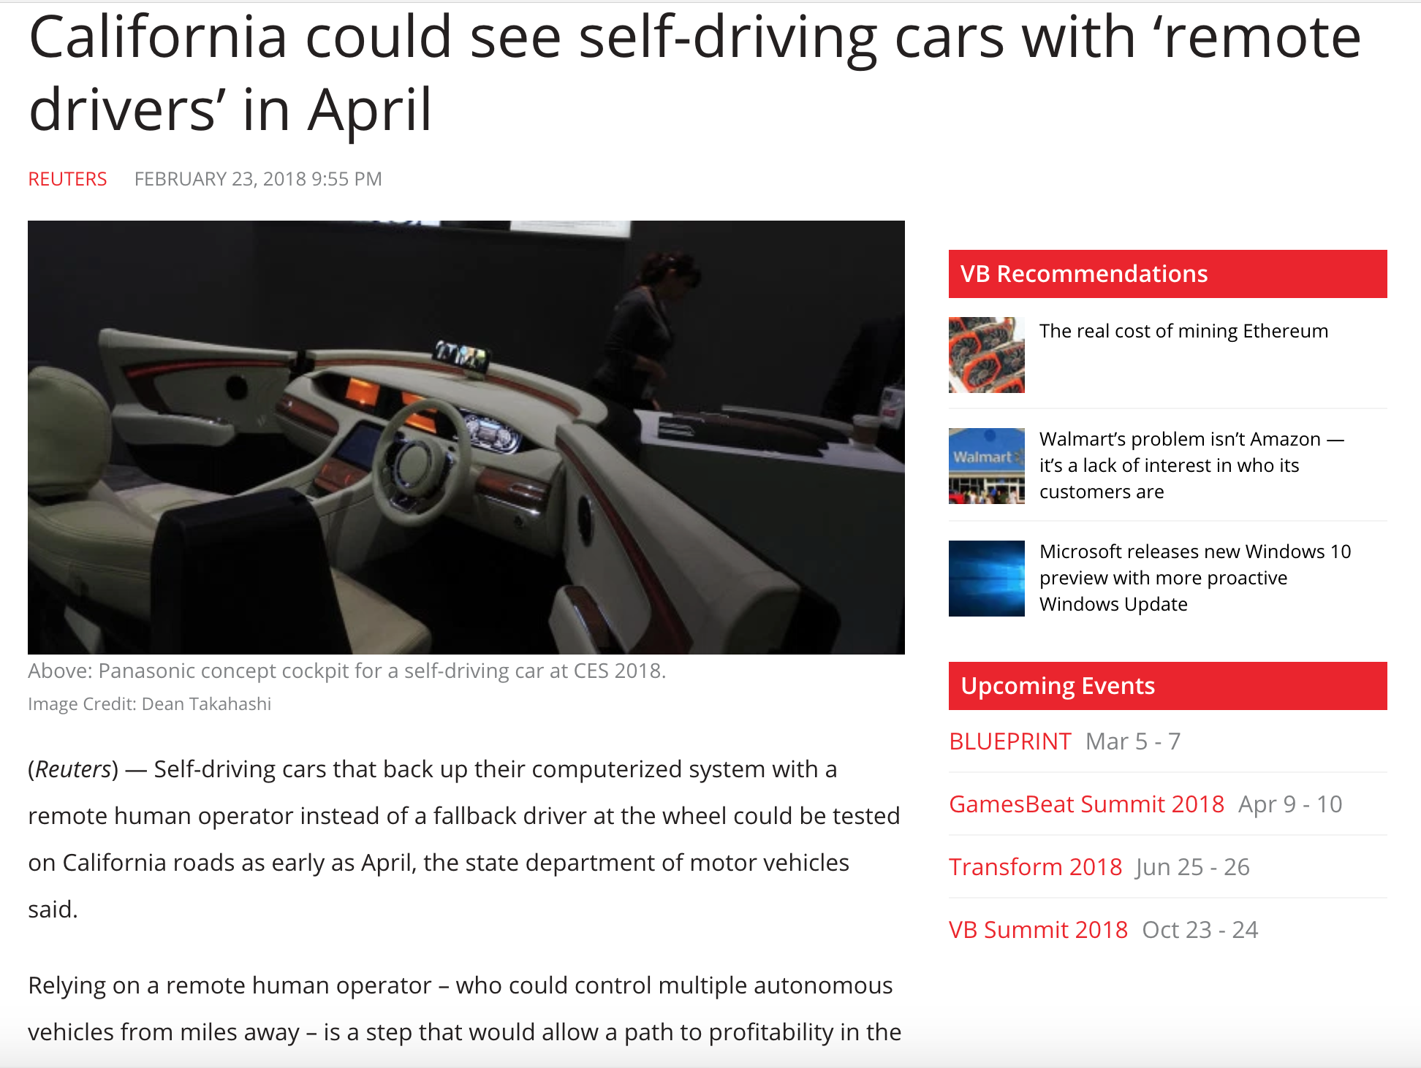

Slide 7
DOMAIN MODEL LAYER 1
TEXT UNDERSTANDING LAYER 2
KNOWLEDGE GRAPH LAYER 3
USER CONTEXT LAYER 4
Original domain model, for eg authors of news, news, views, original topics, etc.
Standard text processing features
Information Extraction
Enrichment
Facts
Knowledge Entities and Semantic relationships
Built from aggregation and validation of layer 1 and 2
Offers Multi-View (Perspectives)
Keeps track of the user conversation
Relates conversation steps to entry points in the Knowledge Graph
Use distance to determine out of context situations

Slide 8
Text Understanding
Natural Language Processing
Sentence segmentation
Tokenization
Stopwords Removal
Part of Speech Tagging

Slide 9
Text Understanding
Natural Language Processing
Sentence segmentation
Tokenization
Stopwords Removal
Part of Speech Tagging
Named Entity Recognition

Slide 10
Text Understanding
CALL ga.nlp.annotate({text: n.text, id: id(n)})

Slide 11
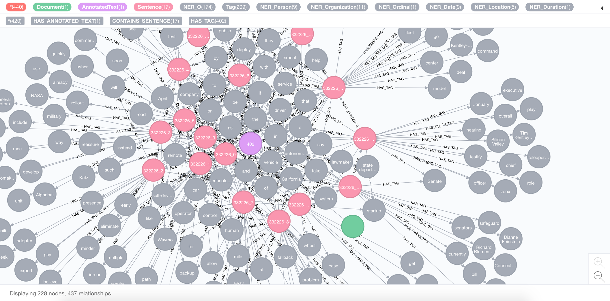

Slide 12
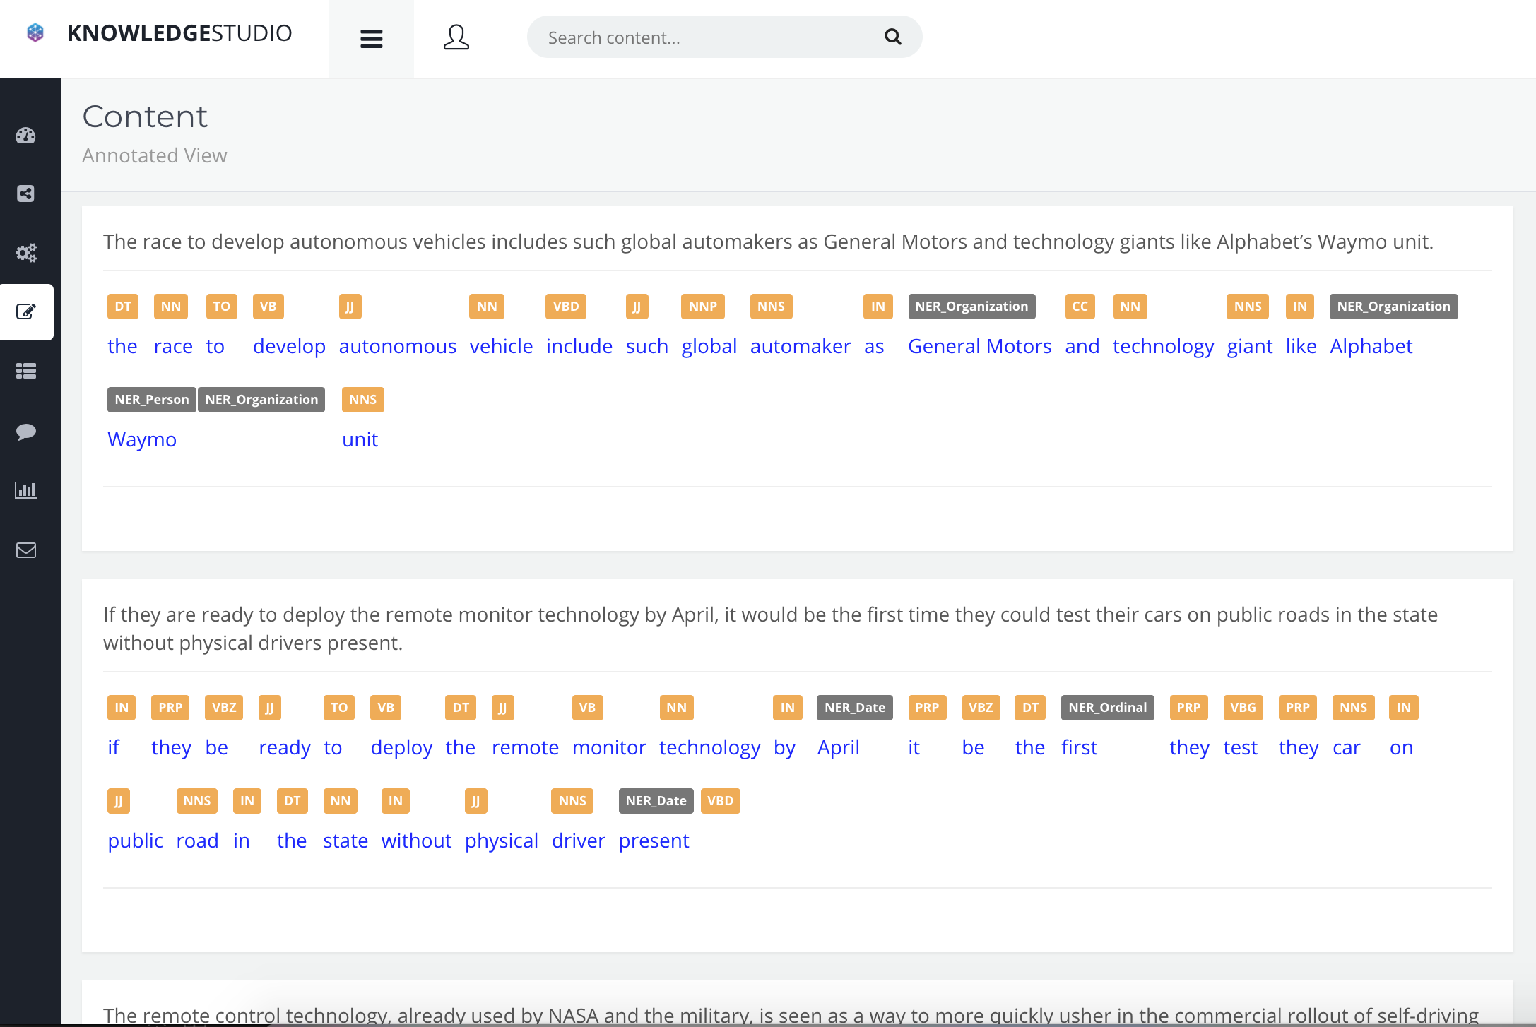

Slide 13
NER

Slide 14
Text Understanding
Natural Language Processing
Sentence segmentation
Tokenization
Stopwords Removal
Part of Speech Tagging
Named Entity Recognition
Syntactic Dependencies Parsing

Slide 15
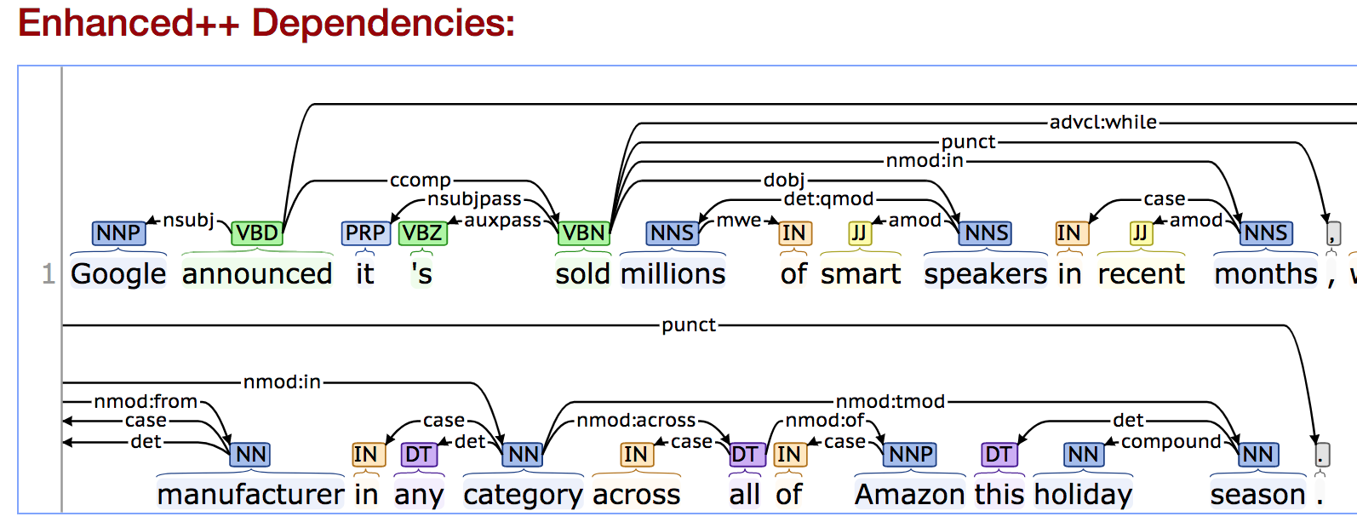

Slide 16
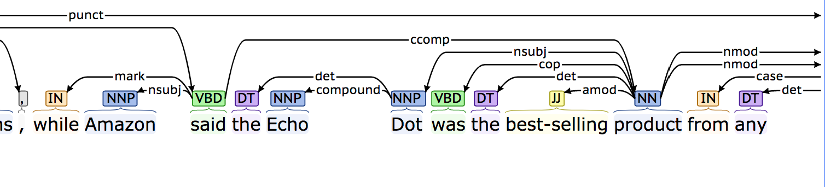

Slide 17
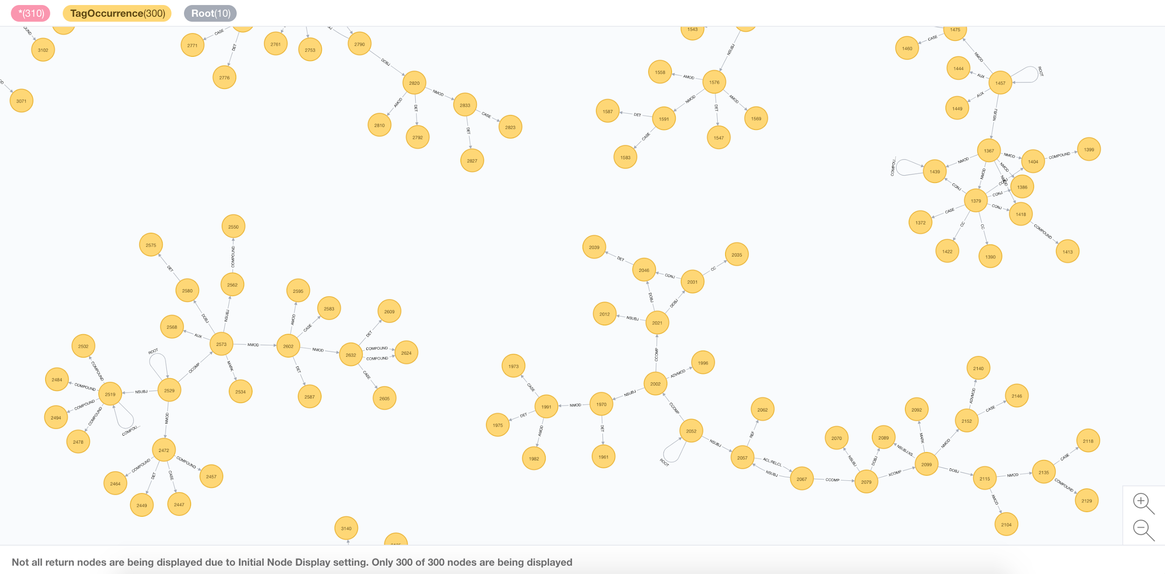

Slide 18
Text Understanding
Facts
Using Semantic Parsers to extract facts from sentences in a Subject-Root-Object form

Slide 19
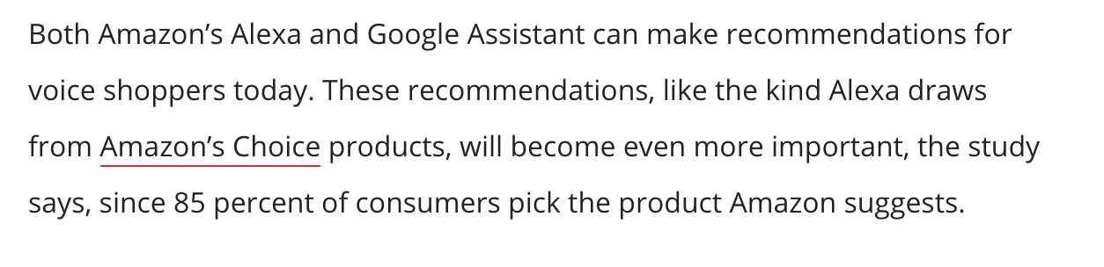

Slide 20
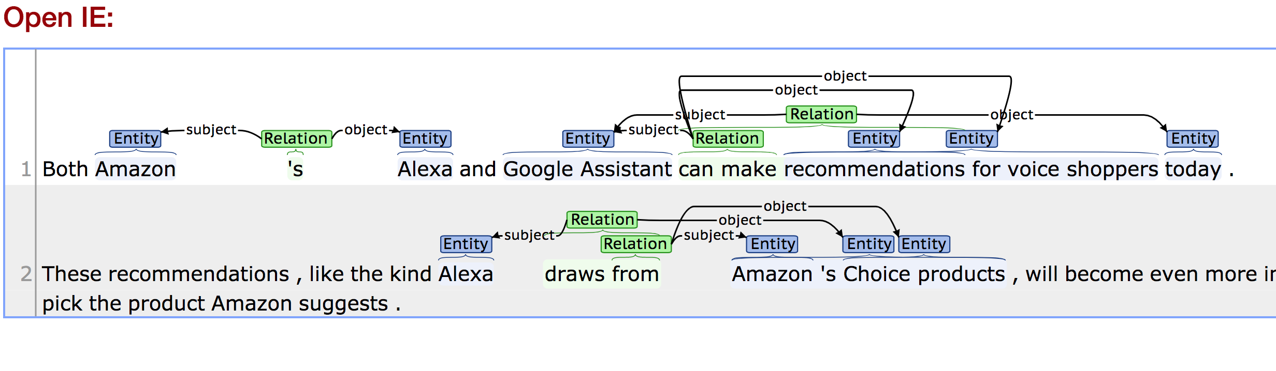

Slide 21
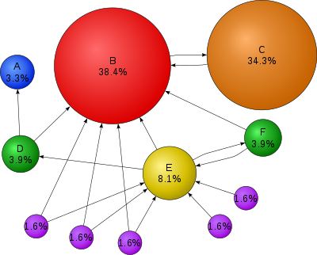
Text Understanding
Keywords Extraction
Unsupervised algorithm
Using TextRank wich under the hood uses PageRank
Performs better than most supervised algorithms
http://bit.ly/graphaware-textrank

Slide 22
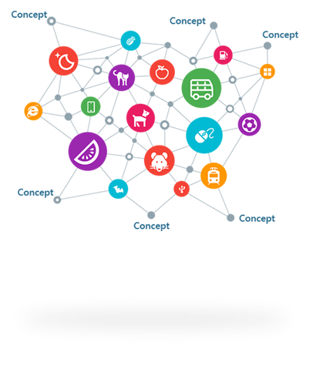
Enrichment

Slide 23
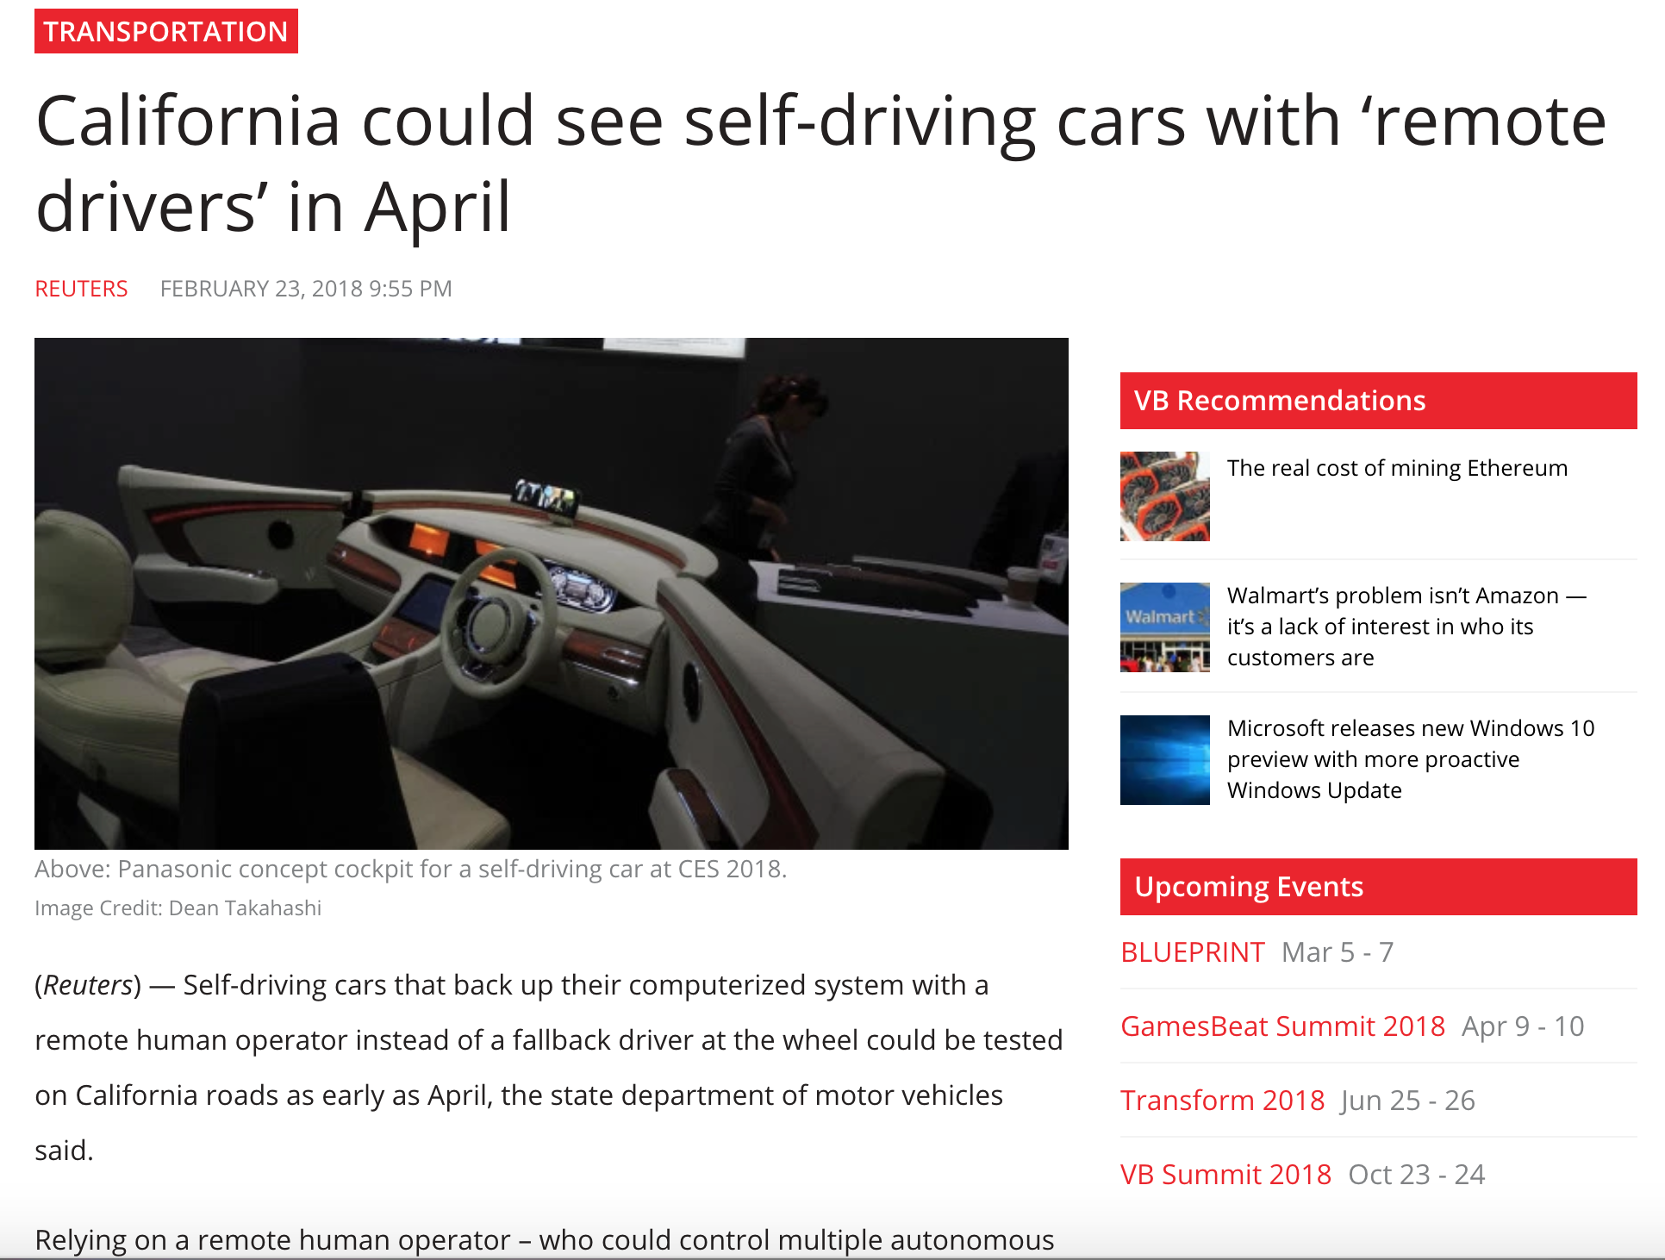

Slide 24
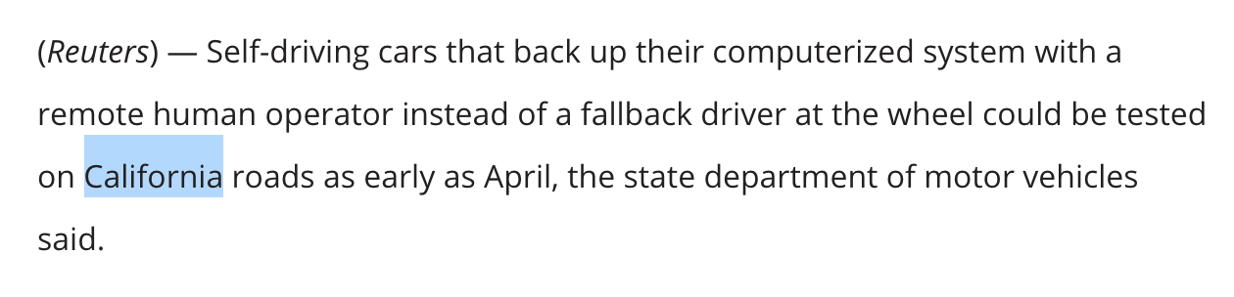

Slide 25
Enrichment
Concept Bases
CALL ga.nlp.enrich.concept ({enricher:’conceptnet5’, node: n})

Slide 26
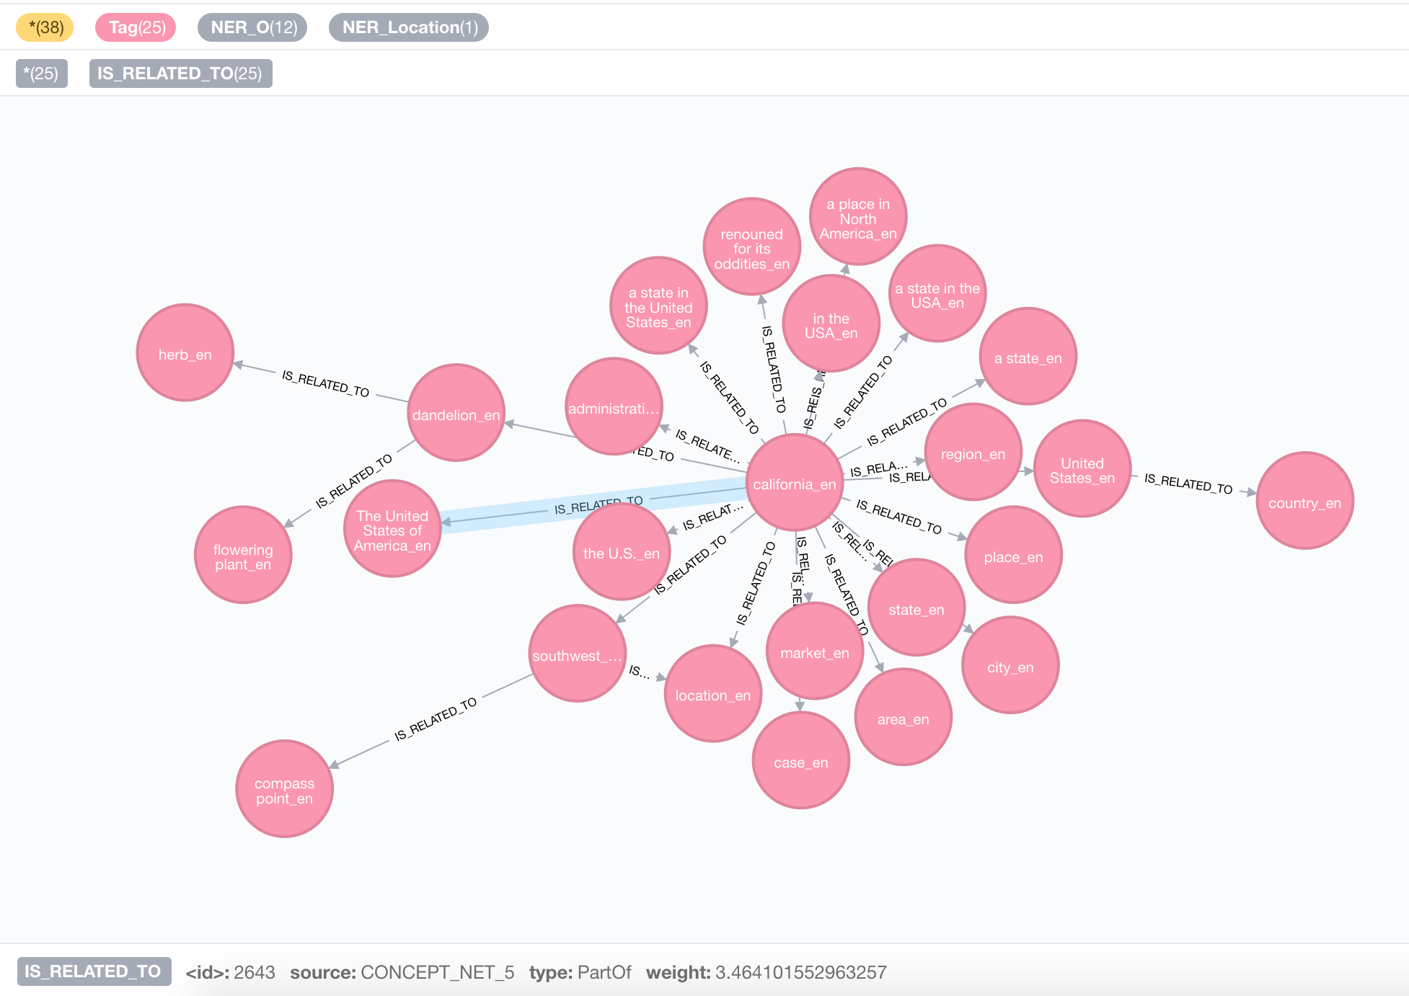
Notes:
This is how the enrichment is represented in the Graph

Slide 27

Enrichment
Visual Metadata

Slide 28
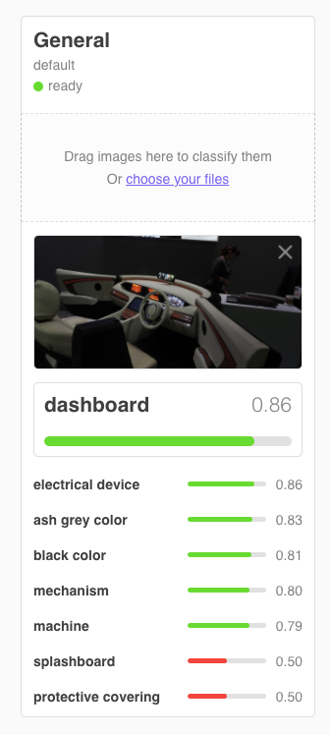

Slide 29

Enrichment
External Knowledge Bases

Slide 30
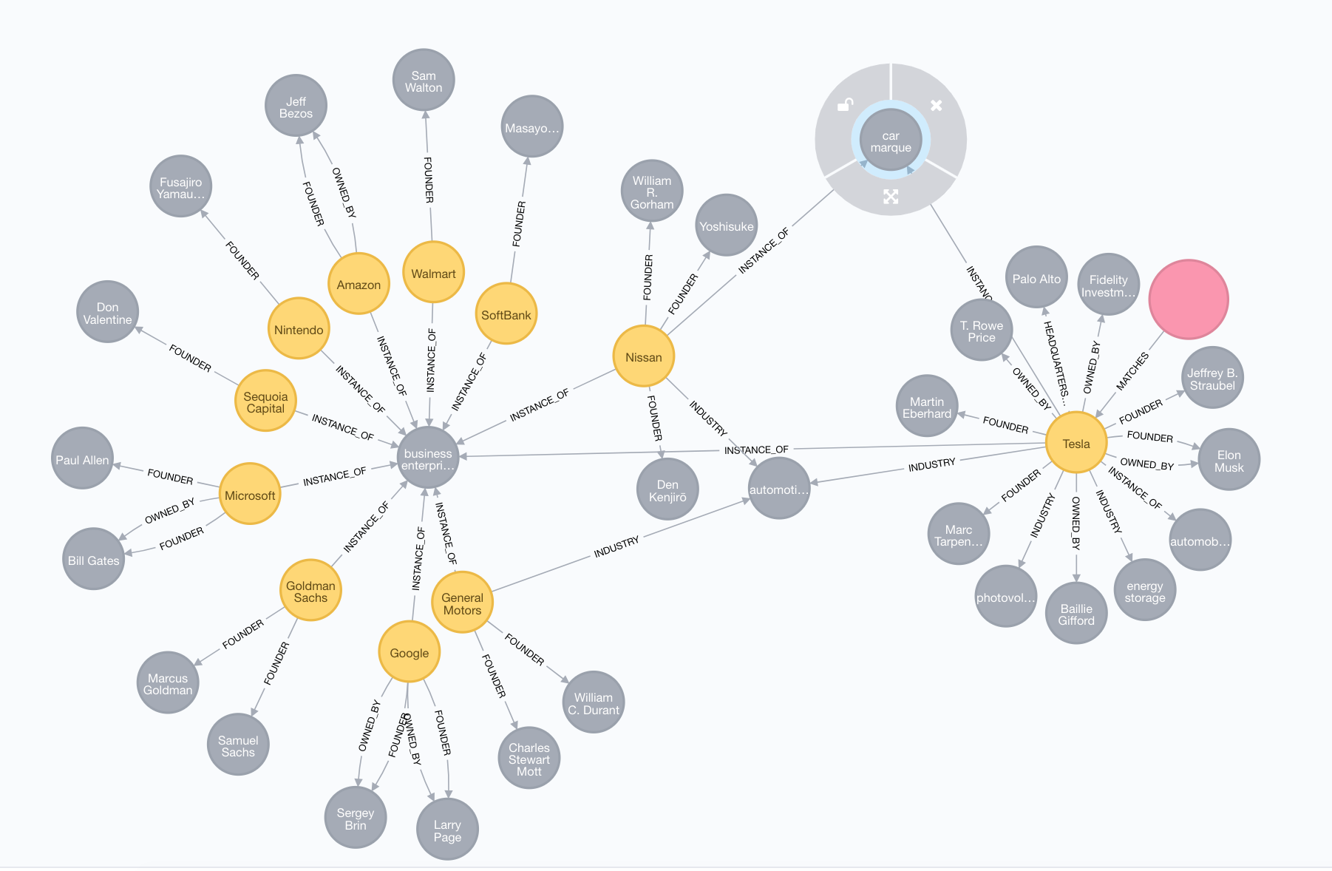

Slide 31
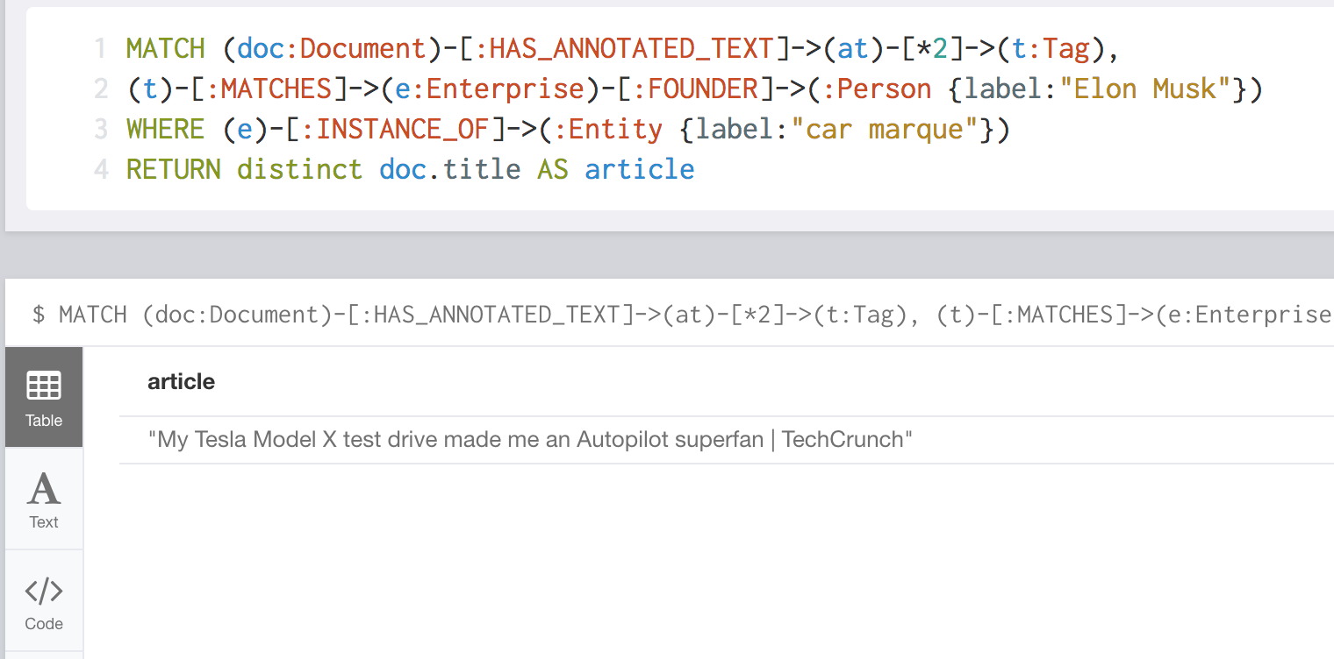
Find articles mentioning companies being founded by Elon Musk and in the car industry

Slide 32
DOMAIN MODEL LAYER 1
TEXT UNDERSTANDING LAYER 2
KNOWLEDGE GRAPH LAYER 3
USER CONTEXT LAYER 4
Original domain model, for eg authors of news, news, views, original topics, etc.
Standard text processing features
Information Extraction
Enrichment
Facts
Knowledge Entities and Semantic relationships
Built from aggregation and validation of layer 1 and 2
Offers Multi-View (Perspectives)
Keeps track of the user conversation
Relates conversation steps to entry points in the Knowledge Graph
Use distance to determine out of context situations

Slide 33
The Knowledge Graph
How to build it ?
Aggregate all the information from the previous steps
Use external tools to validate some assumptions, e.g. : Director of marketing -> corporate position
Create a new graph from those informations

Slide 34
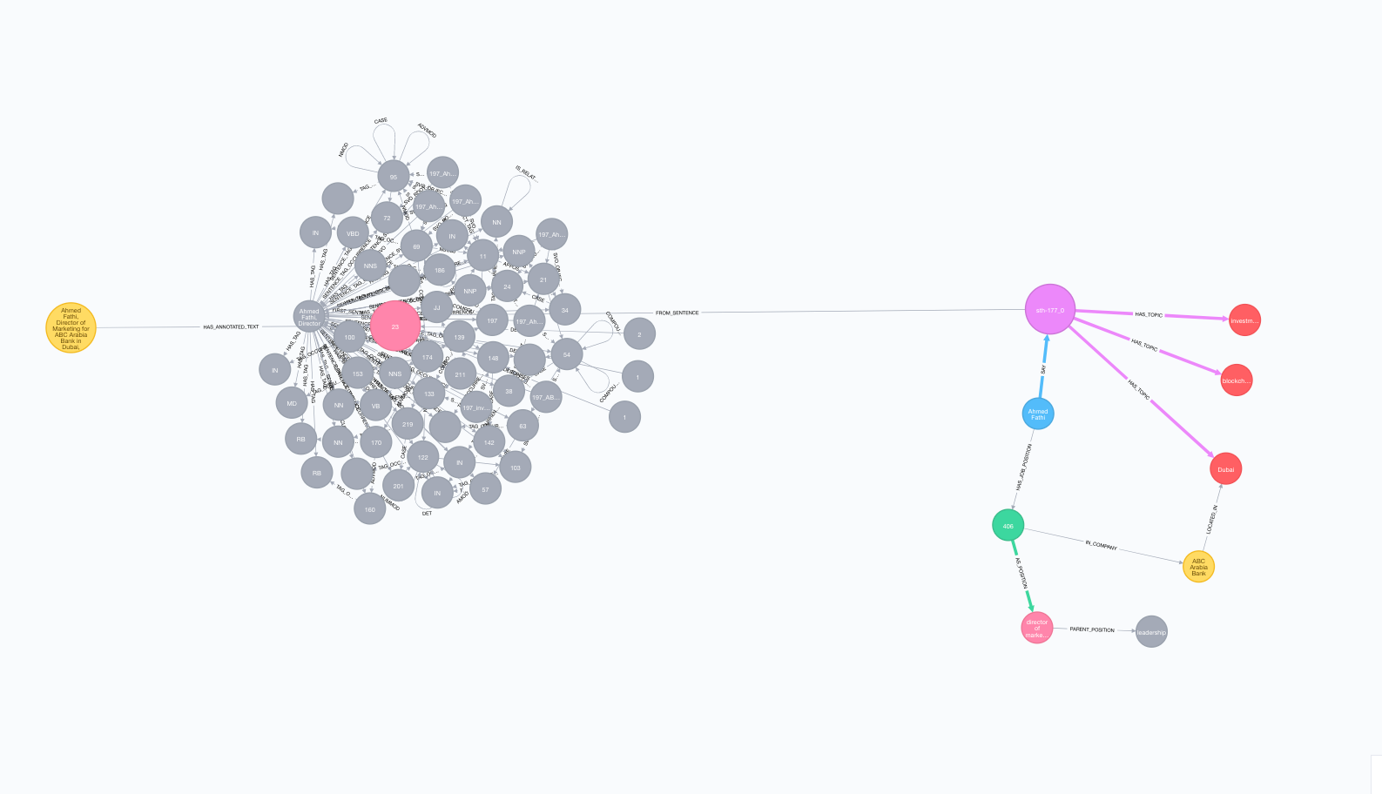

Slide 35
Knowledge Graphs to power Advanced Applications

Slide 36
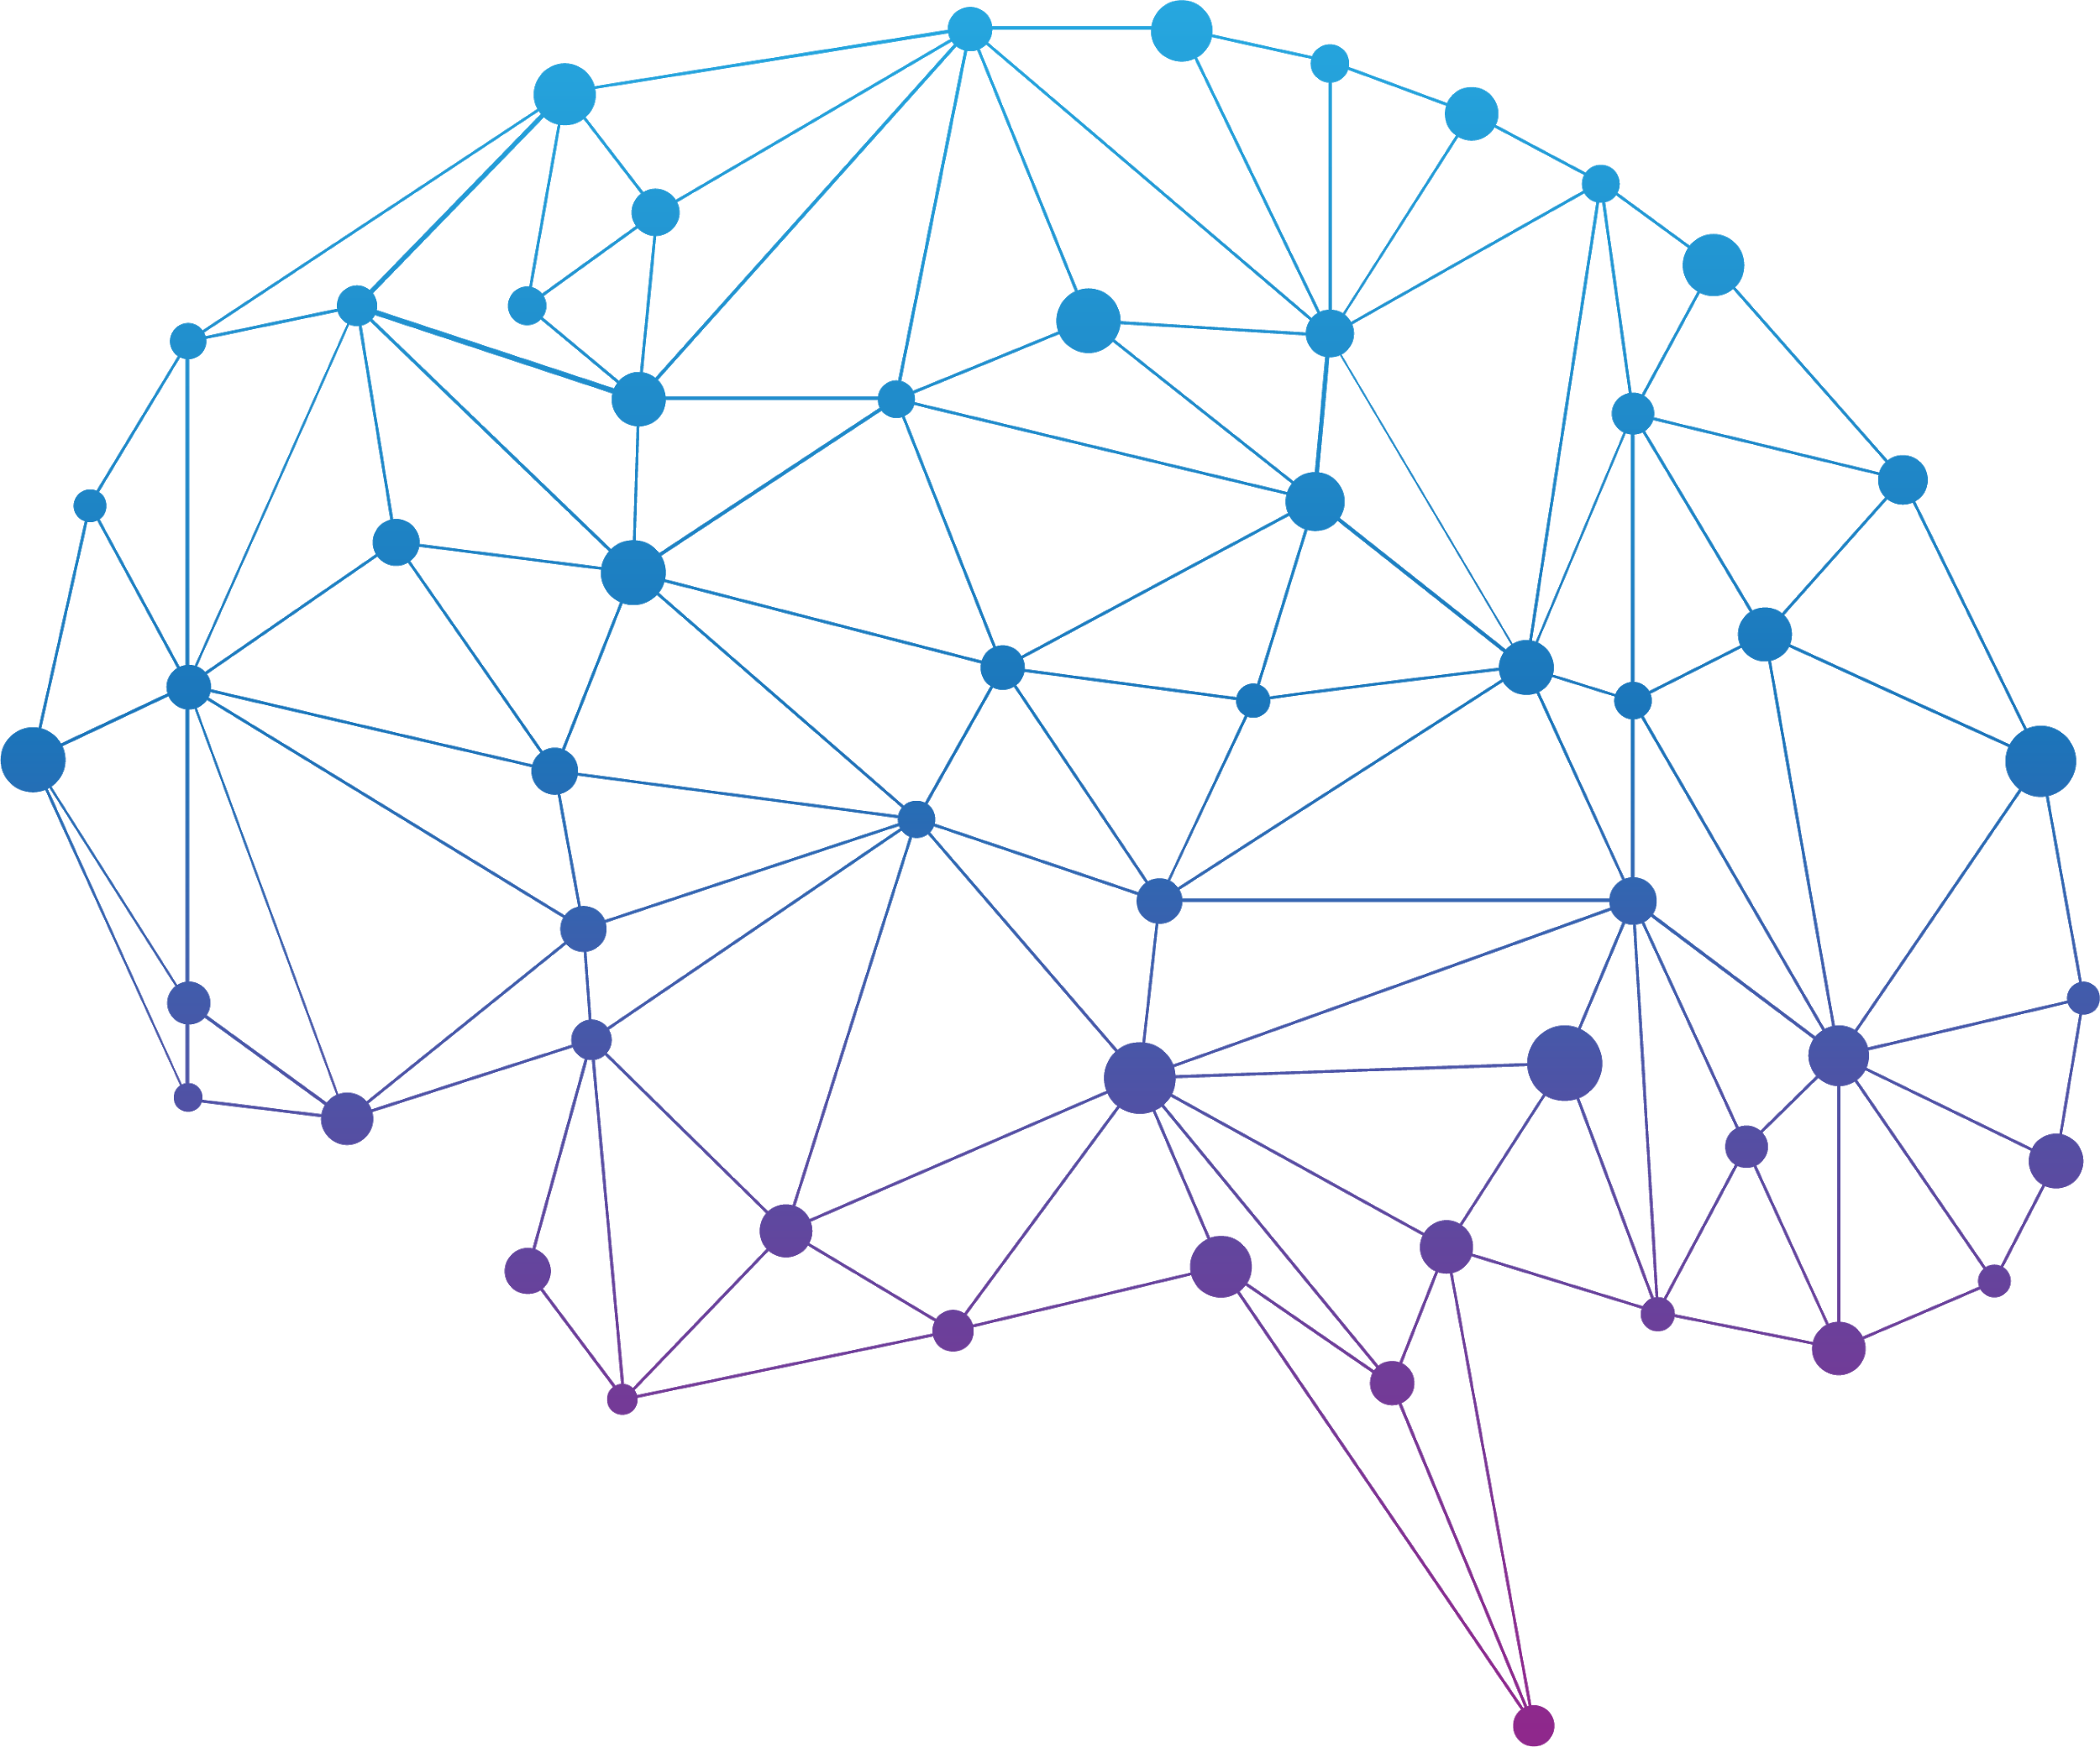
BrainBro

Slide 37
Knowledge Graphs IRL
NER issues

Slide 38
Knowledge Graphs IRL
NER issues
Default recognizers are trained on generic texts and will often perform poorly when lot of indentation is used
Dropbox IPO, Forty Seven, Consumer Business Group, Melinda Gates Foundation (without Bill), …
You can “easily” build your own models with external knowledge bases like wikidata

Slide 39
Knowledge Graphs IRL
Phonetic Matching
SOUNDEX, DOUBLE METAPHONE, FUZZY
ELASTIC PHONETIC ANALYSIS PLUGIN

Slide 40
Knowledge Graphs IRL
Visual Metadata Validation

Slide 41
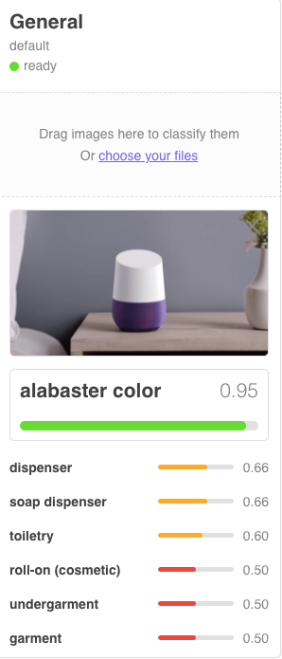

Slide 42
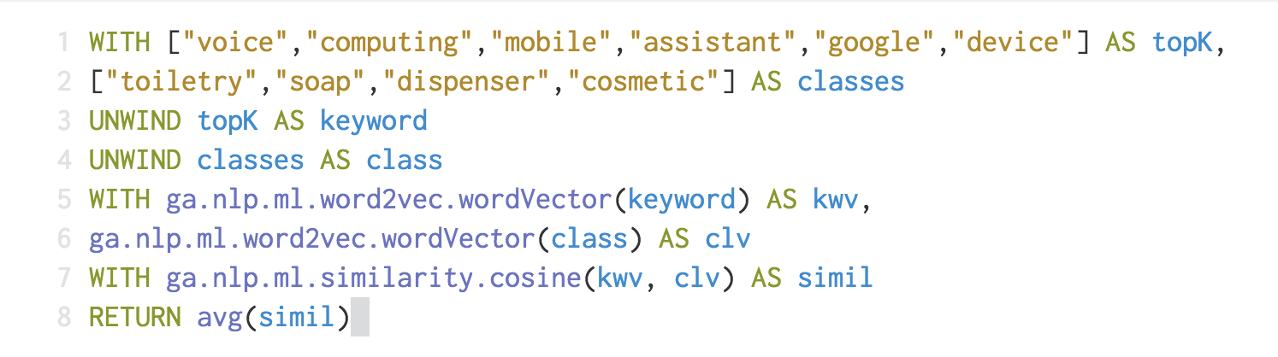
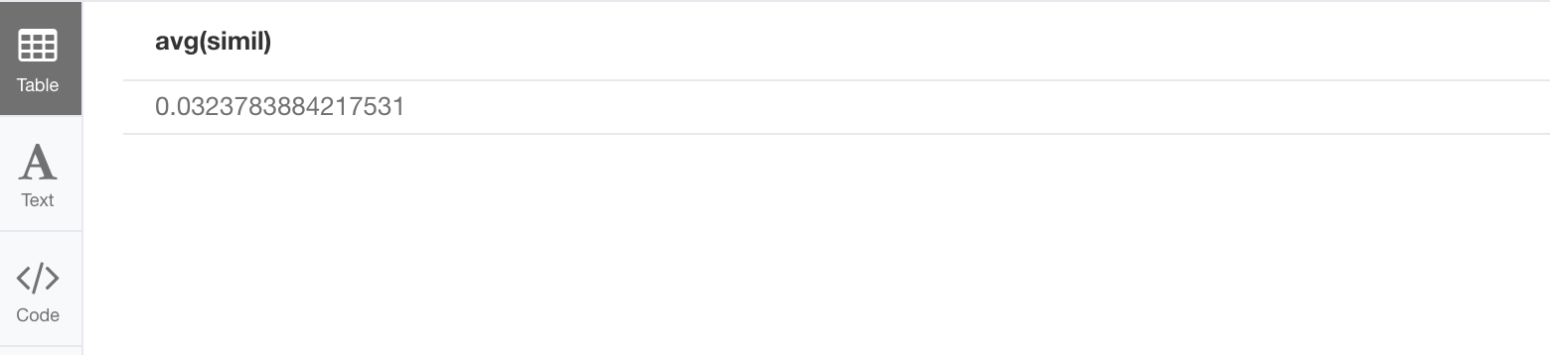

Slide 43
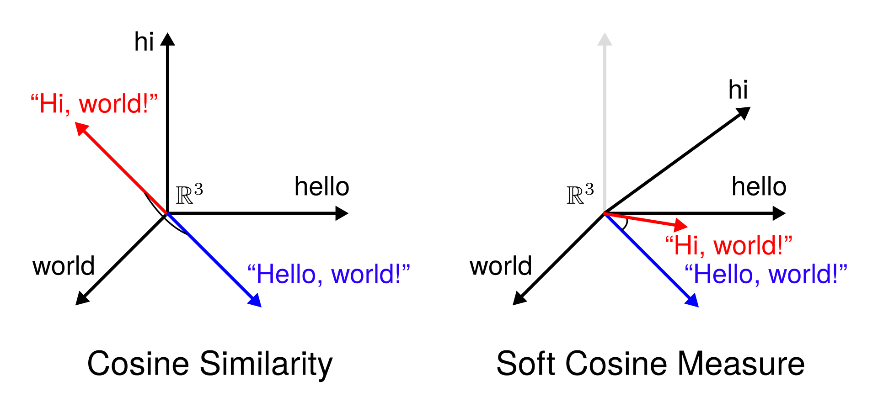
Knowledge Graphs IRL
Visual Metadata Validation
Build a top-k vocabulary of the article, or the surrounding article parts of the image
Use word2vec to compute relevancy of class labels returned by image recognition services
Use SCM ( Soft Cosine Measure ) [1] [2]
Grigori Sidorov et al. Soft Similarity and Soft Cosine Measure: Similarity of Features in Vector Space Model, 2014. (link to PDF)
Delphine Charlet and Geraldine Damnati, SimBow at SemEval-2017 Task 3: Soft-Cosine Semantic Similarity between Questions for Community Question Answering, 2017. (link to PDF)

Slide 44
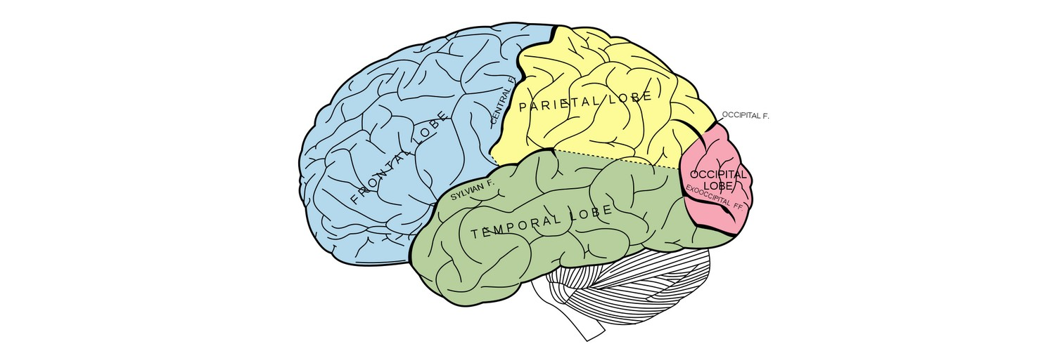
Visual and Temporal Memory for Recall

Slide 45
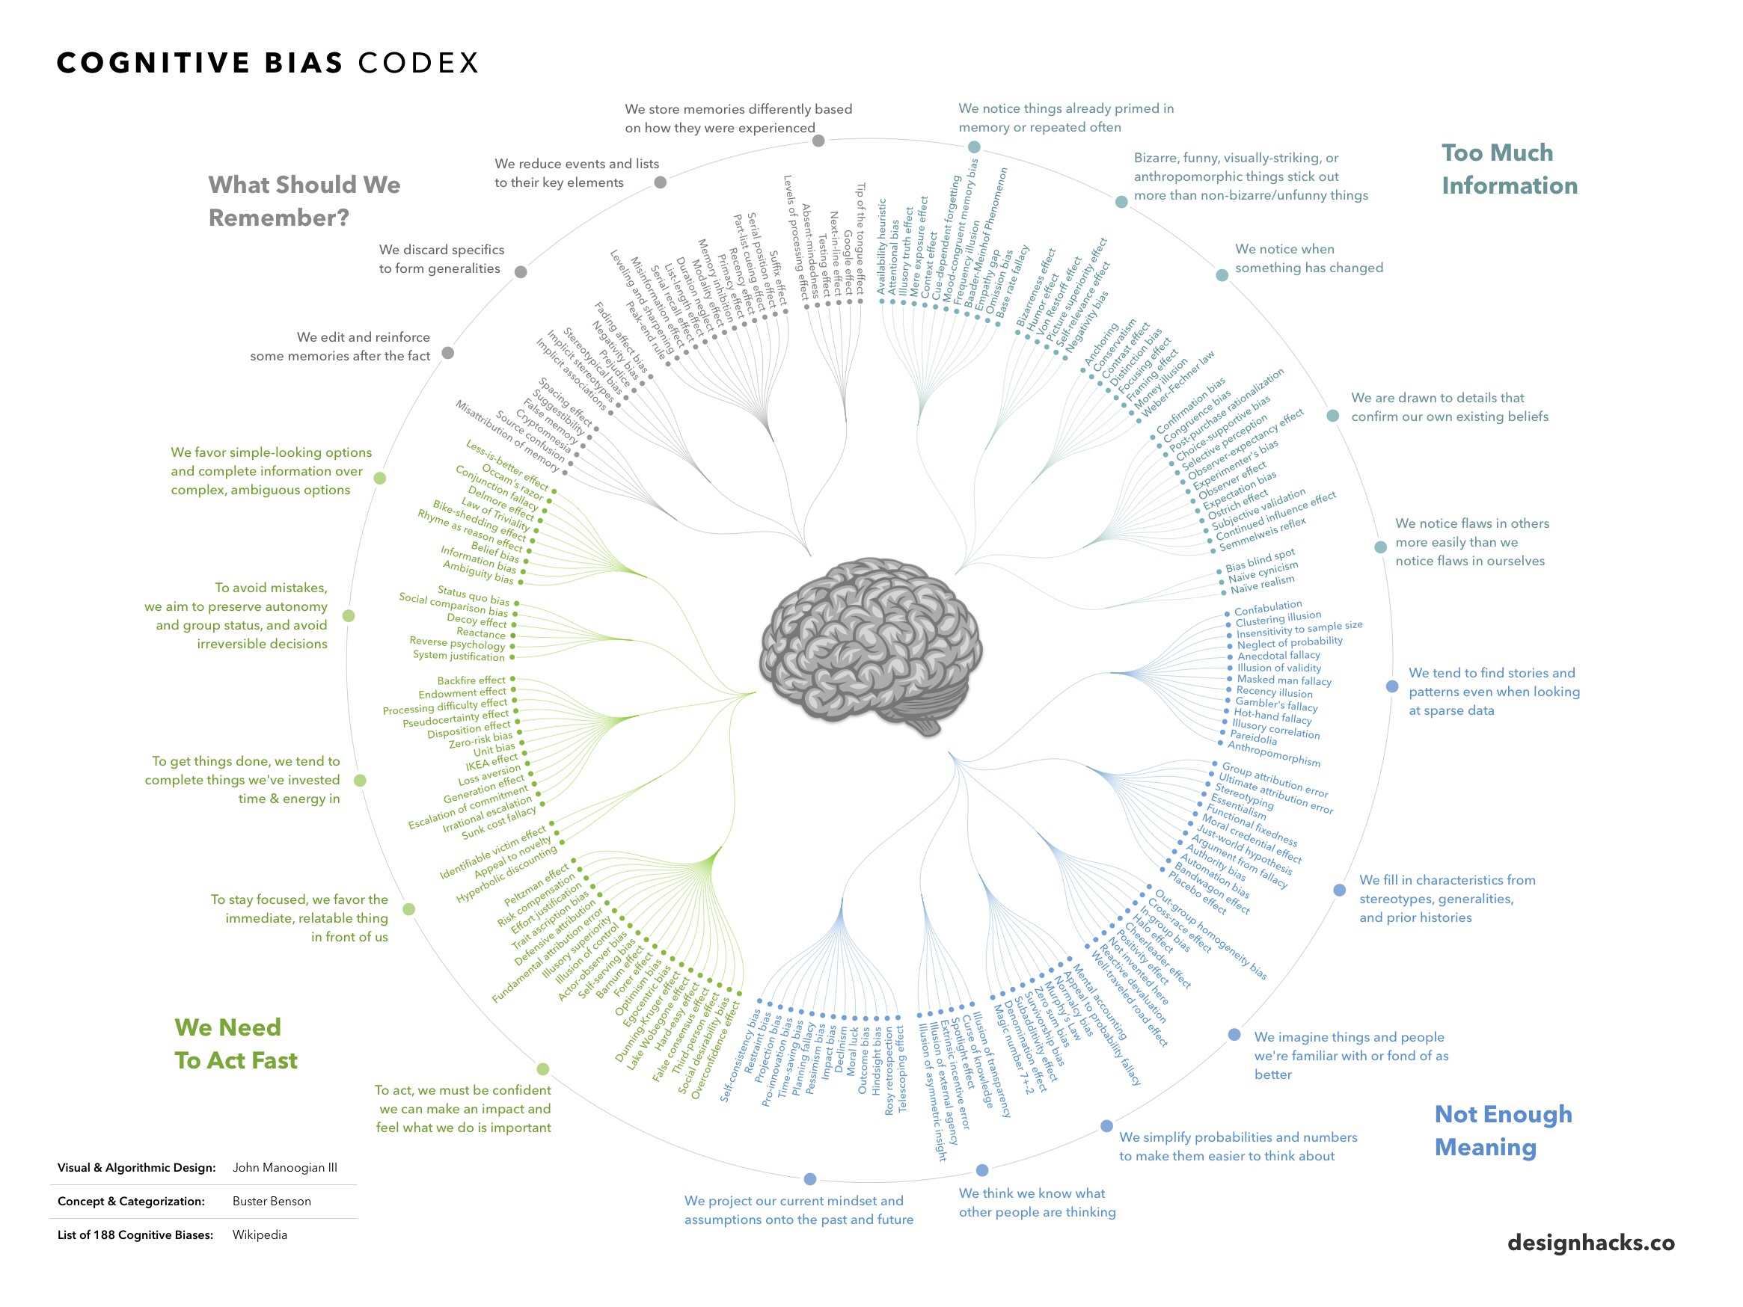

Slide 46
DOMAIN MODEL LAYER 1
TEXT UNDERSTANDING LAYER 2
KNOWLEDGE GRAPH LAYER 3
USER CONTEXT LAYER 4
Original domain model, for eg authors of news, news, views, original topics, etc.
Standard text processing features
Information Extraction
Enrichment
Facts
Knowledge Entities and Semantic relationships
Built from aggregation and validation of layer 1 and 2
Offers Multi-View (Perspectives)
Keeps track of the user conversation
Relates conversation steps to entry points in the Knowledge Graph
Use distance to determine out of context situations

Slide 47
Querying Knowledge
Intent detection
What did Ahmed Fathi say about blockchains ?
Where is ABC Arabia Bank located ?
What does a person with a leader position think about investment banks ?

Slide 48
Querying Knowledge
Intent detection
What did Ahmed Fathi say about blockchains ?
Where is ABC Arabia Bank located ?
What does a person with a leader position think about investment banks ? Understand what we want out of the knowledge graph

Slide 49
Querying Knowledge
Intent detection
What did Ahmed Fathi say about blockchains ?
Where is ABC Arabia Bank located ?
What does a person with a leader position thinks about investment banks ? Understand what we want out of the knowledge graph
Looking for facts?

Slide 50
Querying Knowledge
Intent detection
What did say Ahmed Fathi about blockchains ?
Where is ABC Arabia Bank located ?
What does a person with a leader position thinks about investment banks ? Understand what we want out of the knowledge graph
Looking for a Location entity

Slide 51
Querying Knowledge
Intent detection
What did say Ahmed Fathi about blockchains ?
Where is ABC Arabia Bank located ?
What does a person with a leader position think about investment banks ? Understand what we want out of the knowledge graph
If you “say” something, do you “think” it ?

Slide 52
Querying Knowledge
Entity Extraction
What did Ahmed Fathi say about blockchains ?
Where is ABC Arabia Bank located ?
What does a person with a leader position think about investment banks ?

Slide 53
Querying Knowledge
Entity Extraction
What did Ahmed Fathi say about blockchains ?
Where is ABC Arabia Bank located ?
What does a person with a leader position think about investment banks ? Determine Entry Points in the Knowledge Graph as well as semantic constraints

Slide 54
Querying Knowledge
Person Entity : Ahmed Fathi Semantic: SAY Topic: blockchain
Entity Extraction
What did Ahmed Fathi say about blockchains ?
Where is ABC Arabia Bank located ?
What does a person with a leader position thinks about investment banks ? Determine Entry Points in the Knowledge Graph as well as semantic constraints

Slide 55
Querying Knowledge
Entity Extraction
What did say Ahmed Fathi about blockchains ?
Where is ABC Arabia Bank located ?
What does a person with a leader position thinks about investment banks ? Determine Entry Points in the Knowledge Graph as well as semantic constraints
Company Entity : ABC Arabia Bank

Slide 56
Querying Knowledge
Entity Extraction
What did say Ahmed Fathi about blockchains ?
Where is ABC Arabia Bank located ?
What does a person with a leader position thinks about investment banks ? Determine Entry Points in the Knowledge Graph as well as semantic constraints
Company Position : Leader position Person: related to position
Semantic: think Topic: investment bank

Slide 57
Querying Knowledge
Query representation
Queries should be treated as original corpus and pass the same set of processing

Slide 58
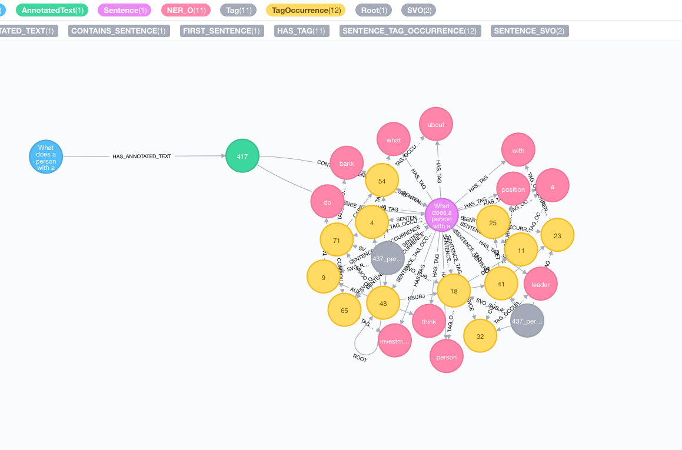

Slide 59
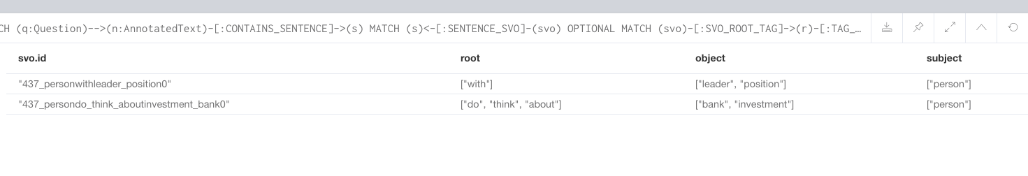
Can this be used to match against a Person label in the Knowledge Graph ?

Slide 60
How to match “do think about” with a “SAY” relationship in the Knowledge Graph?

Slide 61
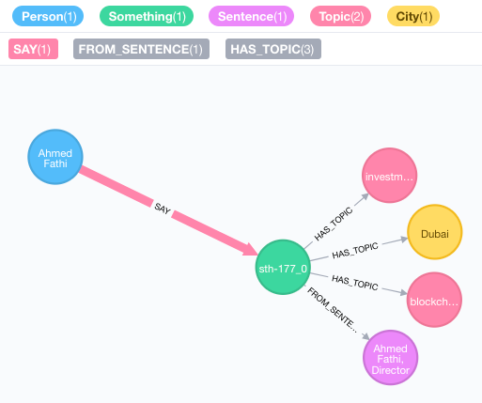
How to match “do think about” to a “SAY” relationship in the Knowledge Graph?

Slide 62
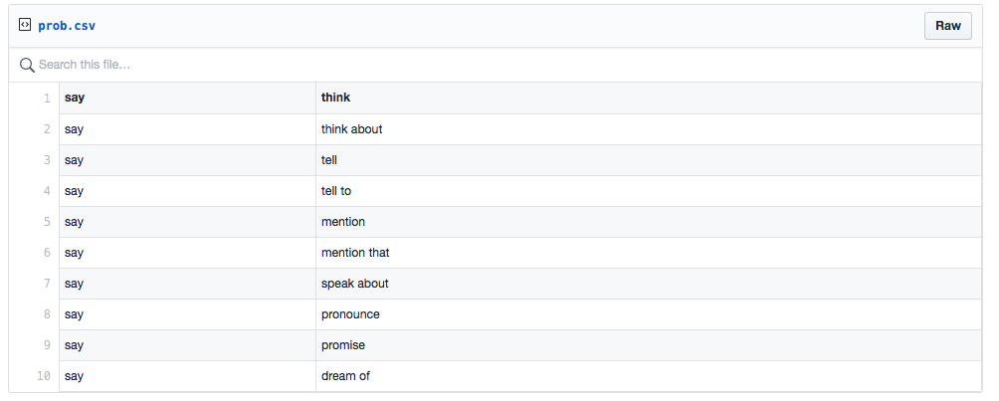
Probabilistic Traversals

Slide 63
Probabilistic Traversals
Use a probability based classifier like Naive Bayes for determining the type of the relationship to traverse
Avoid to return non-relevant results in a “Always return something architecture”

Slide 64
Dynamic Query Stack
Depending on the intent, the graph should be queried differently, there is no rocket science out of the box answer to how, just knowing your domain and lot lot lot of failures and tests
The Knowledge Graph is queried but not only that, you could also query the NLP graph for tf-idf enforcement and score the results with different weights at the end

Slide 65
Queries made
EntityLinking()
EntitiesSimilarity()
SemanticSimilarity()
TraversalProbability()
KeywordSensitivePageRank()
TopicSensitivePageRank()
TF-IDF()

Slide 66
Lot of techniques
Minimum subgraph matching
Sequence pattern recognition for SVO generation when queries are not parsed fully
Voice adaptations aka soundex
Deep learning
...

Slide 67
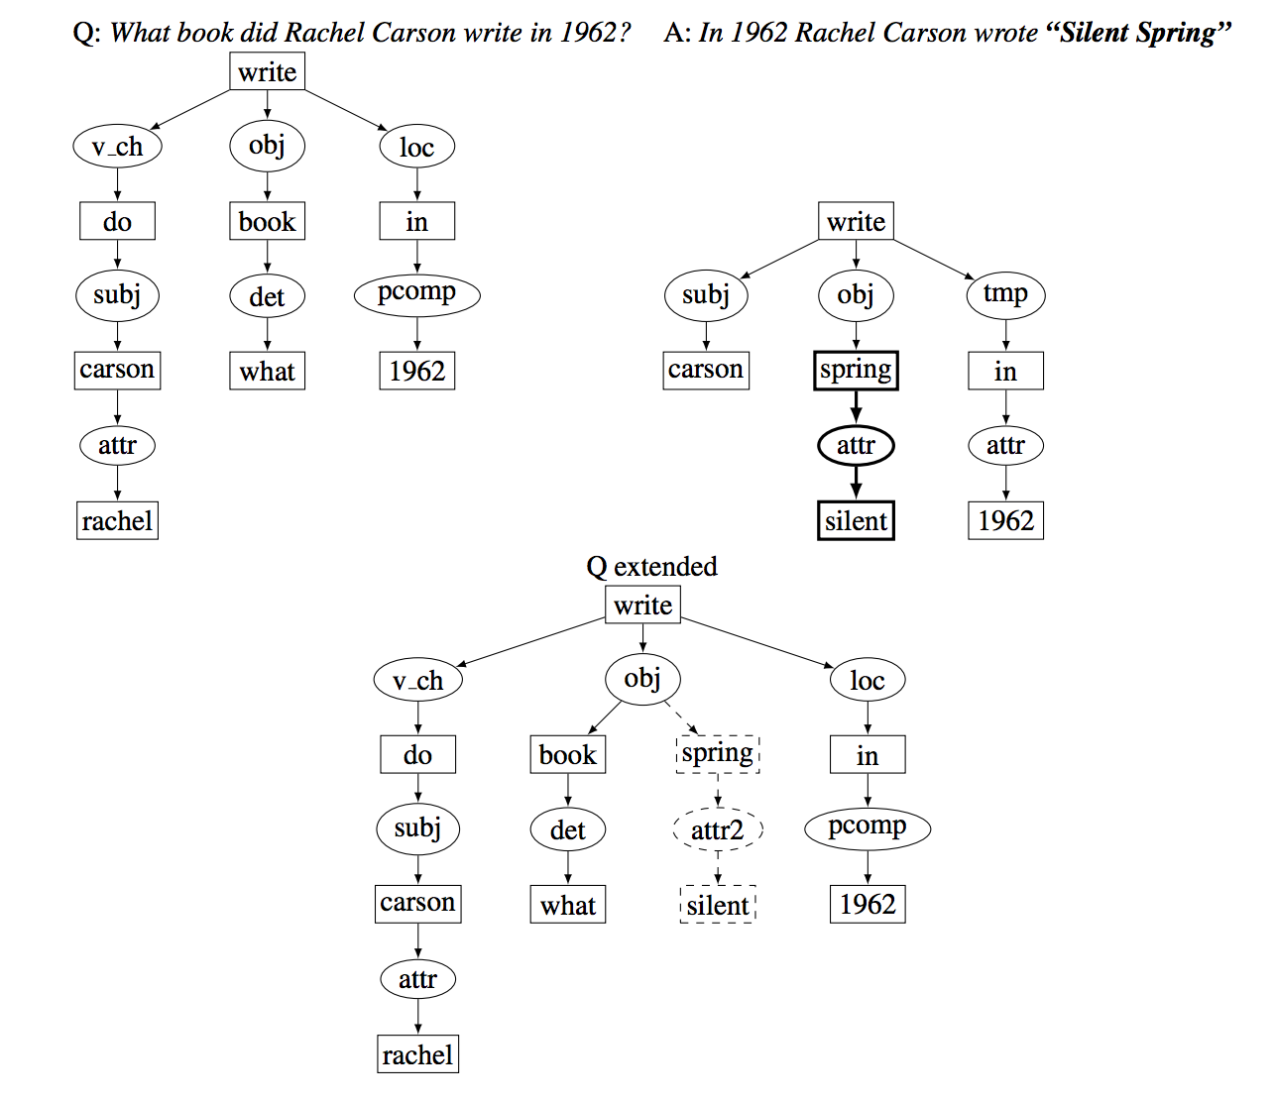

Slide 68
User Query and Context

Slide 69
User Context
Conversation
After all, chatbots are considered as Conversational Interfaces, it wouldn’t have this name if the end goal of such systems is having a conversation with a machine
Keeping track of where the user is in the conversation can help to add more constraints to the queries

Slide 70
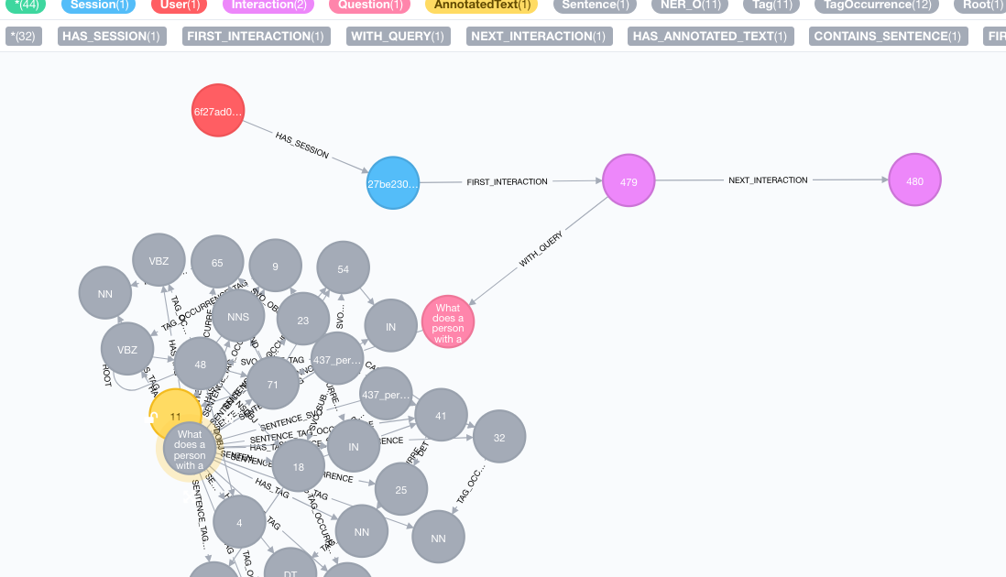

Slide 71
User Context
When to go out ?
A user can quickly go out of context during a conversation, for example : * How is the weather in San Francisco ? -- it is 25 degrees * what size? -- ?? Are you really gonna try to find a response?
We use distance calculation in the graph based to trigger Signals if the user is out of context

Slide 72
Some more thoughts
Embrace failures
Monitor
Humans are still a thing
..

Slide 73

Thank you !
Christophe Willemsen @ikwattro
world’s #1 Neo4j consultancy
www.graphaware.com @graph_aware

